Slide 1



Scholarly Big Data Analytics
马 帅

Slide 2

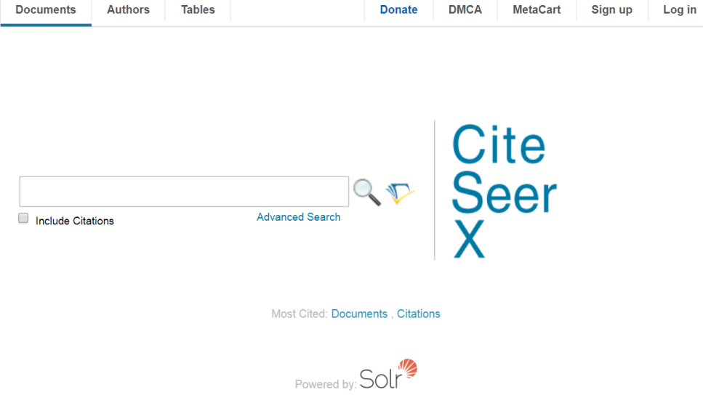




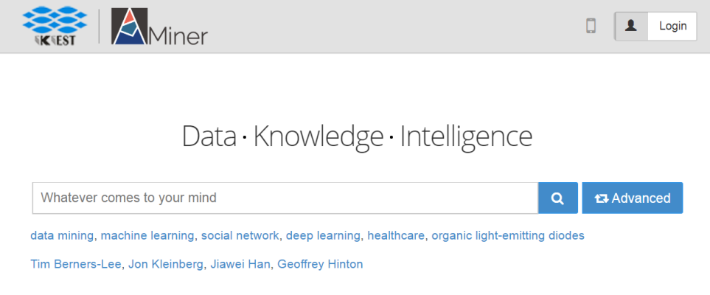
To aid the deep understanding of scholarly data and to facilitate the research activities of scholars for scientific studies
A number of scholarly search systems have been developed, which essentially provide searches and profiling of scholarly entities (articles, authors, venues and affiliations).

Slide 3
Outline
Query Independent Scholarly Article Ranking
Scholar Name Disambiguation
Scholarly Citation Cycle Detection and Cleaning
Athena: Ranking Enabled Scholarly Search System

Slide 4



Query Independent Scholarly Article Ranking
Goal: giving static ranking based on scholarly data only
Applications
Playing a key role in literature recommendation systems, especially in the cold start scenario
For search engines, determining the ranking of results
WSDM Cup 2016 http://www.wsdm-conference.org/2016/wsdm-cup.html

Slide 5
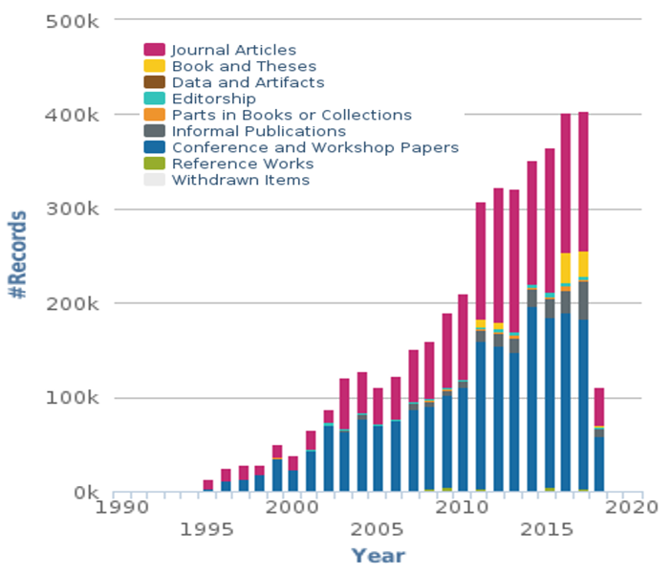
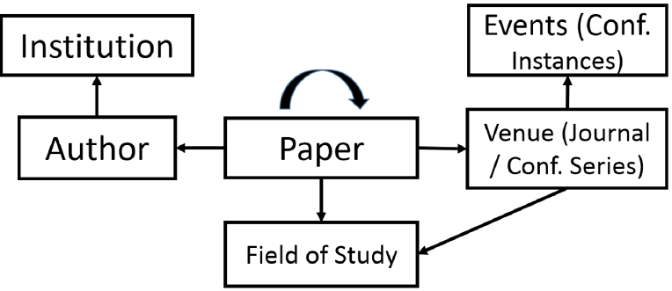
Query Independent Scholarly Article Ranking
Challenges：heterogeneous, evolving & dynamic
Multiple types of entities involve with different contributions
Entities and their importance evolve with time
Academic data is dynamic and continuously growing
The Microsoft Academic Graph [Sinha et al. 2015]
New Records per year of dblp Database
Arnab Sinha, et al. An Overview of Microsoft Academic Service (MAS) and Applications. In WWW, 2015.
https://dblp.uni-trier.de/statistics/newrecordsperyear.html

Slide 6
Query Independent Scholarly Article Ranking
Our Solution
Ranking Model
Time Weighted PageRank - Evolving
Ranking with Importance Assembling - Heterogeneous
Block-wise Ranking Computation - Large
Dynamic Ranking Computation - Dynamic
Shuai Ma, Chen Gong, Renjun Hu, Dongsheng Luo, Chunming Hu, Jinpeng Huai:Query Independent Scholarly Article Ranking. ICDE 2018: 953-964

Slide 7
Why Weighted PageRank?
Traditional PageRank
Assumption of equally propagating
Articles are equally influenced by references
Bias: favor older articles while underestimate new ones
Not all citations are equal ^{[Valenzuela et al. 2015]}
Different articles typically have different impacts
Weighted PageRank
Key: how to determine the weights (differentiate impacts)
M. Valenzuela, V. Ha and O. Etzioni. Identifying Meaningful Citations. In AAAI Workshop, 2015.

Slide 8
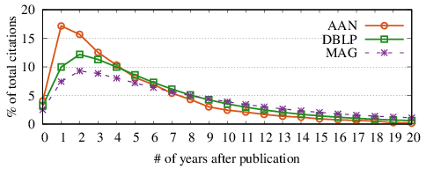
Intuitions of Impacts of Articles
Time decaying
Most previous work simply decays exponentially ^{[1-4]}
When to decay?
[1] X. Li, B. Liu and P. Yu. Time sensitive ranking with application to publication search. In ICDM, 2008.
[2] Y. Wang et al. Ranking scientific articles by exploiting citations, authors, journals and time information. In AAAI, 2013.
[3] H. Sayyadi and L. Getoor. Future rank: Ranking scientific articles by predicting their future pagerank. In SDM, 2009.
[4] D. Walker et al. Ranking scientific publications using a model of network traffic. Journal of Statistical Mechanics: Theory and Experiment, 2007.

Slide 9
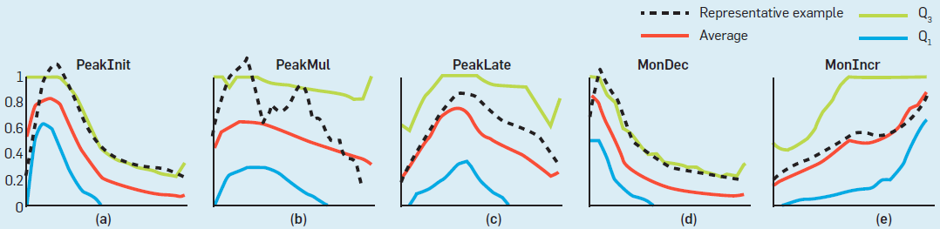
When to Decay
Different patterns for different articles ^{[Chakraborty et al. 2015]}
Categorized by when articles reach their citation peaks
PeakInit, PeakMul, PeakLate, MonDec, MonIncr, Other
Different Citation Patterns[Chakraborty et al. 2015]
Decaying only after the peak time of each individual article
Tanmoy Chakraborty, Suhansanu Kumar, Pawan Goyal, Niloy Ganguly, et al. On the categorization of scientific citation profiles in computer sciences. Commun. ACM 2015.

Slide 10
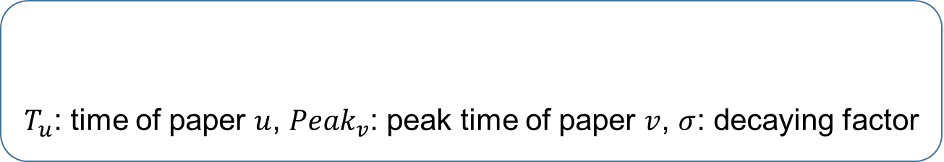
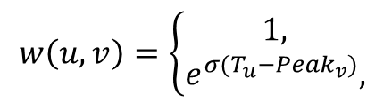
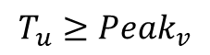
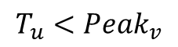
Our Time-Weighted PageRank
Importance propagation based on time-weighted impacts
Time-weighted impact
$T_{u}$: time of paper $u$, ${Peak}_{v}$: peak time of paper $v$, $σ$: decaying factor
$$w\left(u,v\right)=\left\{\begin{aligned}1, \\ &e^{σ(T_{u}−{Peak}_{v})}, \end{aligned}\right.$$
$$T_{u}<{Peak}_{v}$$
$$T_{u}≥{Peak}_{v}$$
Decaying with time only after the peak time
Each individual article has its own peak time
Remarks
Considering the temporal information and dynamic impacts
Alleviating the bias through decayed time-weighted impacts

Slide 11
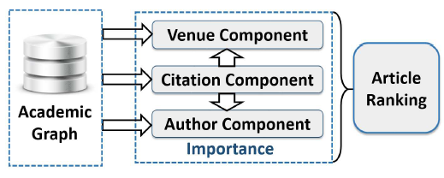
Why Importance Assembling?
Cold start case: ranking new articles
No citations yet: only using citation information fails
Venue and author information should be incorporated
Observation
Multiple types of entities involve with different contributions
Assembling the different contributions of citation, venue and author components

Slide 12
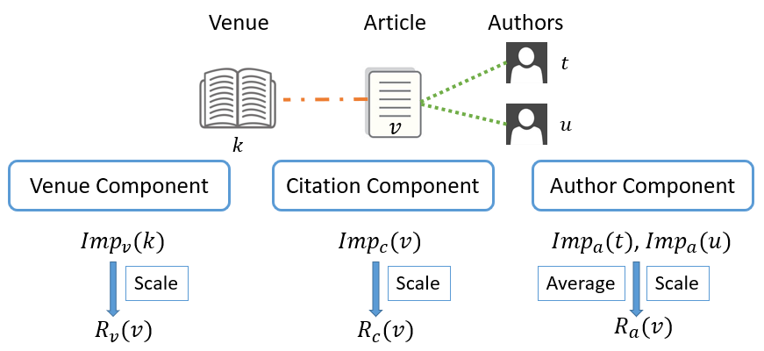

Ranking with Importance Assembling
Importance is defined as a combination of the prestige and popularity
favoring those with recent citations
$Imp\left(v\right)={Prs\left(v\right)}^{λ}{Pop\left(v\right)}^{1−λ},$$λ$: importance weighing factor
favoring those with citations soon after publication
Final ranking
$$R\left(v\right)=αR_{c}\left(v\right)+βR_{v}\left(v\right)+(1−α−β)R_{a}(v)$$
𝛼 and 𝛽: aggregating parameters

Slide 13
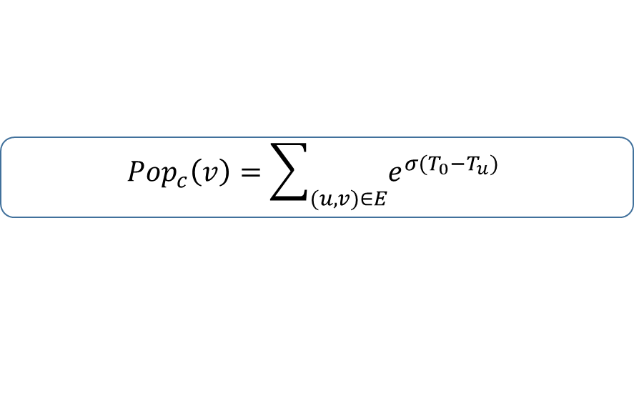
Batch Algorithm batSARank
Importance
Popularity computation
Can be done by scanning all citations once
Prestige computation
Traditionally computed by TWPageRank in an iterative manner and is the most expensive computation
Adopting block-wise computation method batTWPR ^{[Berkhin 2005]}
Treating each strong connected component (SCC) as a block
Processing blocks one by one following topological orders
The edges between blocks are only scanned once
$$Imp\left(v\right)={Prs\left(v\right)}^{λ}{Pop\left(v\right)}^{1−λ}$$
$${Pop}_{c}\left(v\right)=\sum_{(u,v)∈E}{e^{σ(T_{0}−T_{u})}}$$
P. Berkhin. Survey: A survey on pagerank computing. Internet Mathematics, vol. 2, no. 1, pp. 73–120, 2005.

Slide 14
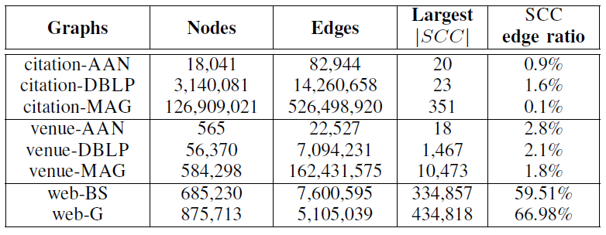
Why Adopting Block-wise Method?
Observation:
citations obey a natural temporal order
SCC edge ratios are small for citation and venue graphs
Based on statistics of scholarly data,
block-wise method is a good choice for TWPageRank
Time complexity analysis
Taking t=100 for example, algorithm batTWPR only needs to scan 4|E| edges on citation and venue graphs, but over 59|E| edges on Web graphs.

Slide 15
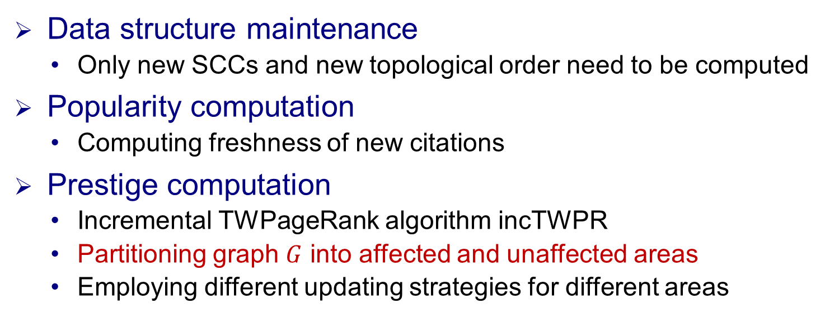
Incremental Algorithm incSARank
Observation on scholarly data
Data only increases without decreasing
Citation relationships obey a natural temporal order
The original block-wise graph and topological order do NOT change
The existing popularity simply needs to be scaled
Data structure maintenance
Only new SCCs and new topological order need to be computed
Popularity computation
Computing freshness of new citations
Prestige computation
Incremental TWPageRank algorithm incTWPR
Partitioning graph $G$ into affected and unaffected areas
Employing different updating strategies for different areas

Slide 16
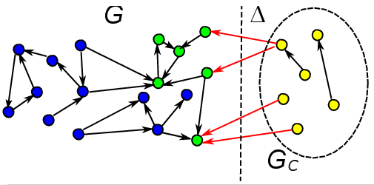
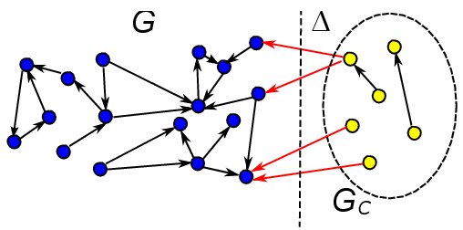
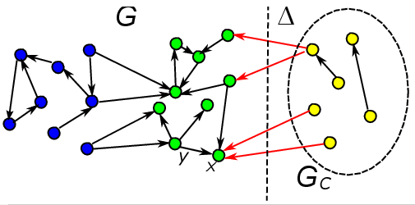
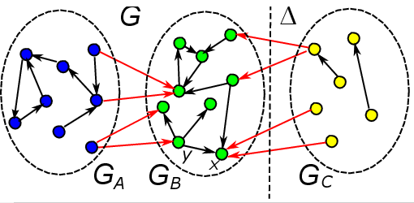
Affected and Unaffected Area Analysis
Affected area
Nodes that are reachable from newly added nodes
Nodes with outgoing edges having weight changes
Nodes that are reachable from other affected nodes
The rest of the original graph is unaffected area
Unaffected Area
Affected Area

Slide 17
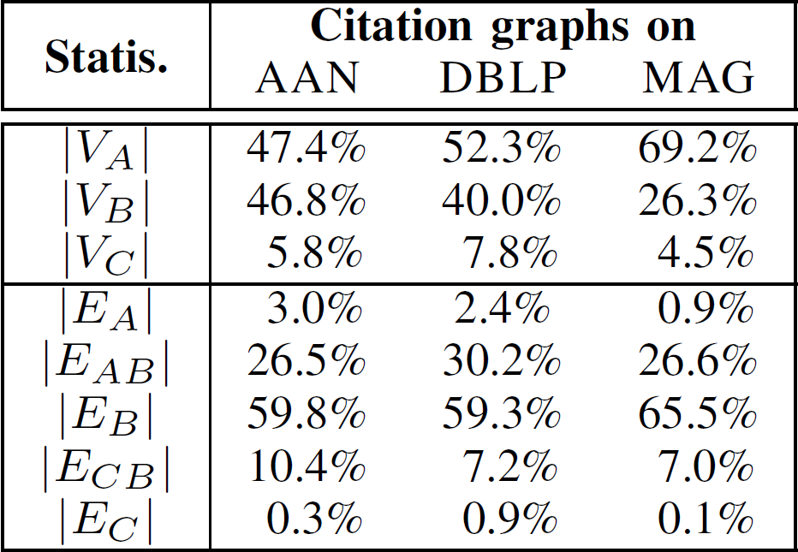
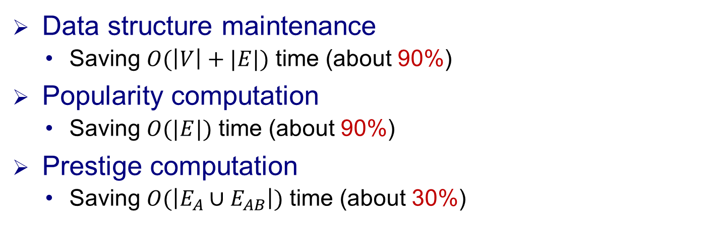
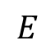
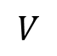
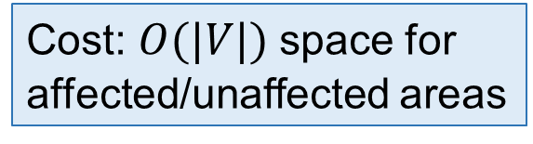
Time Complexity Analysis
Data structure maintenance
Saving $O(\left|V\right|+|E|)$ time (about 90%)
Popularity computation
Saving $O(|E|)$ time (about 90%)
Prestige computation
Saving $O(\left|E_{A}∪E_{AB}\right|)$time (about 30%)
Cost: $O(|V|)$space for affected/unaffected areas
$$V$$
$$E$$

Slide 18
Experimental Settings
Ground-truth:
RECOM ^{[Liang et al. 16]}, which assumes articles with more recommendations are more important
PFCTN for article ranking in a concerned year (splitting year)
Simply using citation numbers for fair evaluation
Past and future citations contribute equally
Articles in the same pairs must be in similar research fields and published in the same years
Articles with more PF citations are more important
total # of PF citations
x years
x years
past
future
start year
splitting year
current year
R. Liang and X. Jiang, Scientific ranking over heterogeneous academic hypernetwork, in AAAI, 2016.

Slide 19
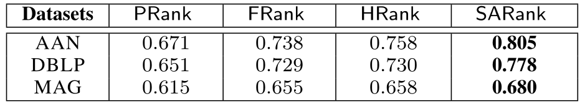
Effectiveness with RECOM
SARank consistently ranks better with RECOM
Note: RECOM is originally given on AAN, and we extend it to DBLP and MAG through exact title matching.

Slide 20
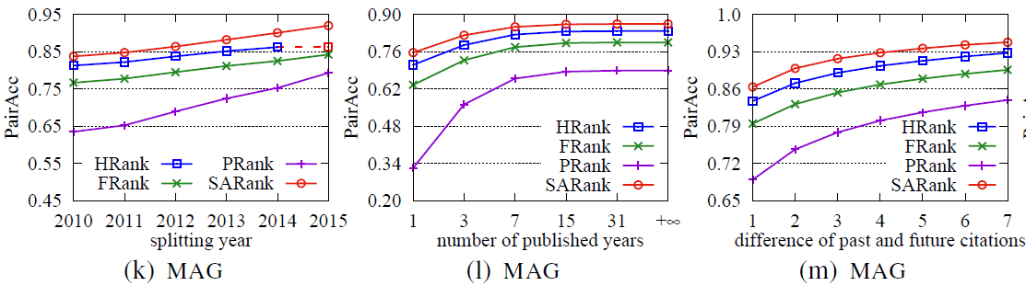
Effectiveness with PFCTN
+16.7%, +7.2%, +2.9%
+23.6%, +8.3%, +3.2%
+13.4%, +6.0%, +2.4%
# of published years
SARank consistently ranks better with PFCTN
start year
article published
splitting year
current year
ranking data

Slide 21
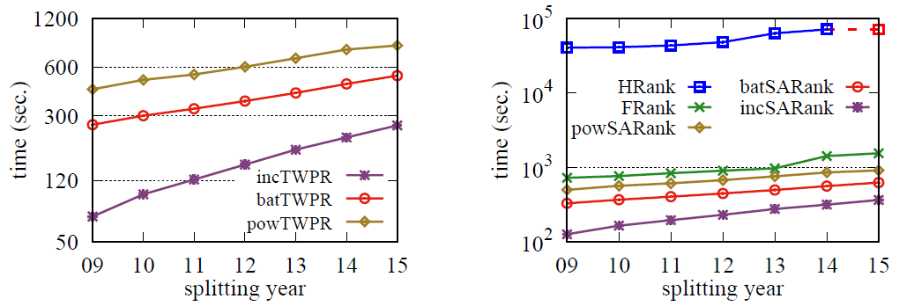
Efficiency
(2.5, 4.1) times faster
(2.0, 3.0, 4.4, 245) times faster
MAG
MAG
Batch and incremental algorithms are more efficient

Slide 22
Outline
Query Independent Scholarly Article Ranking
Scholar Name Disambiguation
Scholarly Citation Cycle Detection and Cleaning
Athena: Ranking Enabled Scholarly Search System

Slide 23

Scholar Name Disambiguation
Scholar name ambiguity is a common data quality problem for digital libraries such as DBLP and Microsoft Academic Search.
Xidian University
Beihang University

Slide 24
Scholar Name Disambiguation
Limited Information is available.
DBLP only provides basic paper and citation information, e.g., author names, publication title, venue and publication year.
Name disambiguation of each name affects others.
Instead of disambiguate each name separately, we treat all author names collectively.

Slide 25
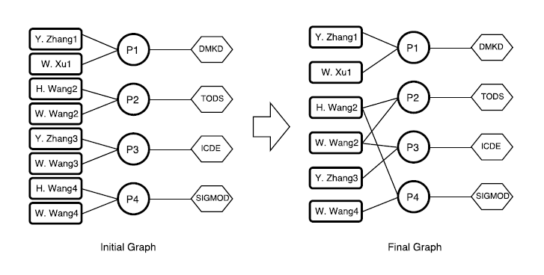
Scholar Name Disambiguation
Problem Formulation
Data representation: heterogeneous information network
Three types of nodes: author, paper, and venue.
Three types of edges: write, publish and mention
Input: a set of citation records.
Output: a clean heterogeneous multipartite network, where each author connects to all and ideally only all papers written by him/her.

Slide 26
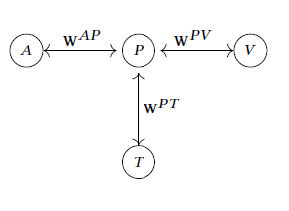
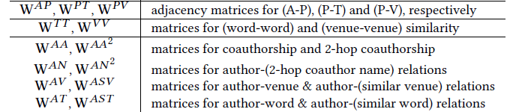
Scholar Name Disambiguation
Coauthorship W^{AA} : matrix for valid coauthorship in G, where W^{AA}(i,j) is the times that authors i and j collaborates.
W^{AA} = W^{AP}×(W^{AP})^{T}− diag(W^{AP} × (W^{AP})^{T}
2-hop coauthorship W^{AA2}: matrix for 2-hop coauthorship in G, where W^{AA2}(i,j) is the number of valid 2-hop coauthorship paths connecting authors i and j.
an APAPA path a_{i}-p_{i}-a_{j}-p_{j}-a_{k}
Matrices W^{AN} and W^{AN2}are for author-(coauthor name) relations and author-(2-hop coauthor name) relations, respectively.
Matrices W^{TT}and W^{VV}for word-word similarity and venue-venue similarity
Matrices W^{AV} and W^{AT} are for author-venue relations and author-word relations, respectively
W^{AV} = W^{AP}× W^{PV} and W^{AT} = W^{AP}× W^{PT}
Matrices W^{AST} and W^{ASV}: author-(similar word) relations and author-(similar venue) relations
W^{AST} = W^{AT}× W^{TT} and W^{ASV} = W^{AV}× W^{VV}

Slide 27
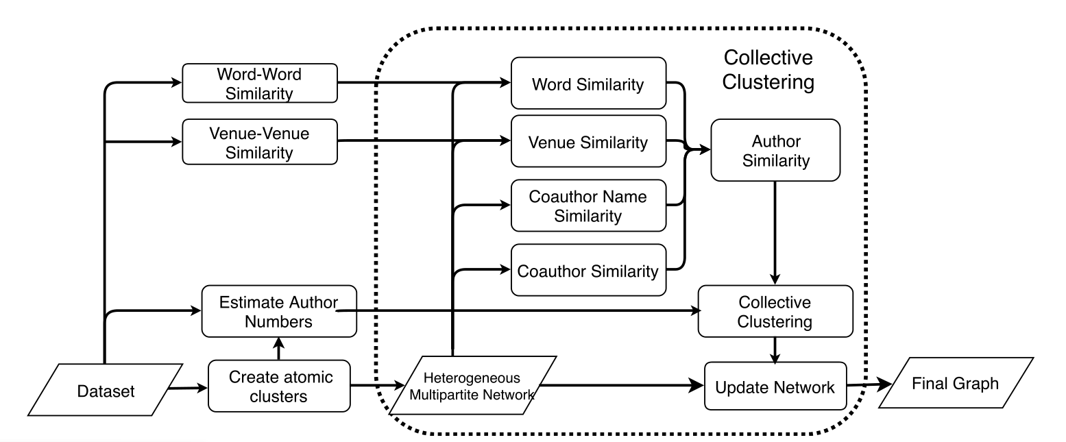
Scholar Name Disambiguation
Solution Framework

Slide 28
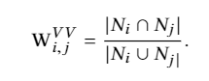
Dealing with Sparsity
Some authors only publish a small number of papers, especially in the initial network. To make a good judgment, we expand the limited information for authors by considering word-word similarity and venue-venue similarity.
Word-word Similarity
Use Word2vec* to learn word representations from normalized titles.
Use cosine similarity of representations to measure the similarity between words.
Venue-Venue Similarity
Two venues are similarity if many authors published papers in both.
Use Jaccard index of their author name sets as the similarity of two venues.
*Tomas Mikolov, Kai Chen, Greg Corrado, and Jeffrey Dean. Efficient estimation of word representations in vector space. arXiv:1301.3781 , 2013

Slide 29
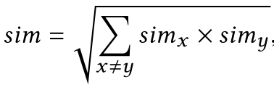
Author Similarity Measurement
The author similarity is assembled by four similarities (coauthor, venue, title and coauthor name)
Given two authors i and j with the same name n, inspired by [18], their similarity is defined as:
where x,y ∈ {n,t,v,a} and sim_{a},sim_{n},sim_{t},sim_{v} are coauthor,
coauthor name, title and venue similarities, respectively
Shaohua Li, Gao Cong, and Chunyan Miao. Author name disambiguation using a new categorical distribution similarity. Machine learning and knowledge discovery in databases, pages 569–584, 2012.

Slide 30
Author Number Estimation
Bootstrap strategies
Finding the atomic clusters as the bootstrap can reduce the size of the initial network,and improve the efficiency.
A simple rule-based method to find the atomic Clusters
Two author references are assigned to the same atomic clusters if they share more than 1 coauthor name
Similar bootstrap strategies are used widely for name disambiguation
Indrajit Bhattacharya and Lise Getoor. Collective entity resolution in relational data. TKDD, 1(1):5, 2007
Jie Tang, A. C. Fong, Bo Wang, and Jing Zhang. A unified probabilistic framework for name disambiguation in digital library. TKDE, 24(6):975–987, 2012.
Xuezhi Wang, Jie Tang, Hong Cheng, and S Yu Philip. Adana: Active name disambiguation. In ICDM, 2011.

Slide 31
Atomic Cluster Generation
Bootstrap strategies
Finding the atomic clusters as the bootstrap can reduce the size of the initial network,and improve the efficiency.
A simple rule-based method to find the atomic Clusters
Two author references are assigned to the same atomic clusters if they share more than 1 coauthor name
Similar bootstrap strategies are used widely for name disambiguation
Indrajit Bhattacharya and Lise Getoor. Collective entity resolution in relational data. TKDD, 1(1):5, 2007
Jie Tang, A. C. Fong, Bo Wang, and Jing Zhang. A unified probabilistic framework for name disambiguation in digital library. TKDE, 24(6):975–987, 2012.
Xuezhi Wang, Jie Tang, Hong Cheng, and S Yu Philip. Adana: Active name disambiguation. In ICDM, 2011.

Slide 32
Stop Condition
We estimate the number of authors for each name with a statistical method*, which is used as the stop condition.
A name is fully disambiguated is the number of authors reaches the estimated one.
Inspired by name ambiguity estimation, we introduce a statistical method, based on the statistics of author names in the bibliography data.
In most cases, names consist of a fixed number of components.
For instance, an English name has three parts: first name, middle name and last name, and a Chinese name consists of the first name and lastname.
Assume that these parts are chosen independently from different multinomial distributions, and the probability of a full author name is the joint probability of its components
*Shaohua Li, Gao Cong, and Chunyan Miao. Author name disambiguation using a new categorical distribution similarity. Machine learning and knowledge discovery in databases, pages 569–584, 2012.

Slide 33
Stop Condition
Given a namen, its first name and last name are denoted by F(n) and L(n), which are independently drawn from multinomial distributions MultiF and MultiL, respectively.
The probability of an author with name n is Pr(n) = MultiF(F(n)) × MultiL(L(n)).
The number of authors with name n is k_{n}= Pr(n) ∑_{e∈N} k_{e}, where k_{e} is the number of authors with name e, and ∑_{e∈N} k_{e} is the total number of authors in the bibliography data
Since k_{e} is unknown, we use its estimate instead.
*Shaohua Li, Gao Cong, and Chunyan Miao. Author name disambiguation using a new categorical distribution similarity. Machine learning and knowledge discovery in databases, pages 569–584, 2012.

Slide 34
Experimental Study
Baselines
CE[1]: unsupervised, another collective method
Ghost[2]: unsupervised, based on coauthor networks
CSLR[3]: unsupervised
MIX[4]: supervised
[1] Indrajit Bhattacharya and Lise Getoor. Collective entity resolution in relational data.TKDD,1(1):5, 2007
[2] Xiaoming Fan, Jianyong Wang, Xu Pu, Lizhu Zhou, and Bing Lv. On graph-based name disambiguation. JDIQ, 2(2):10, 2011
[3] Shaohua Li, Gao Cong, and Chunyan Miao. Author name disambiguation using a new categorical distribution similarity. Machine learning and knowledge discovery in databases , pages 569–584, 2012.
[4] Madian Khabsa, Pucktada Treeratpituk, and C Lee Giles. Online person name disambiguation with constraints. In JCDL, 2015

Slide 35
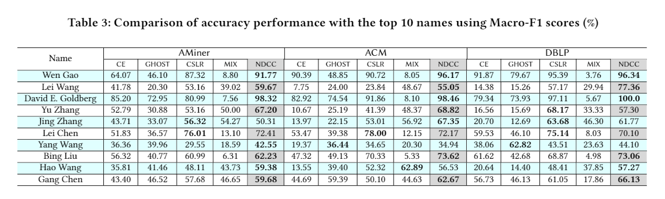
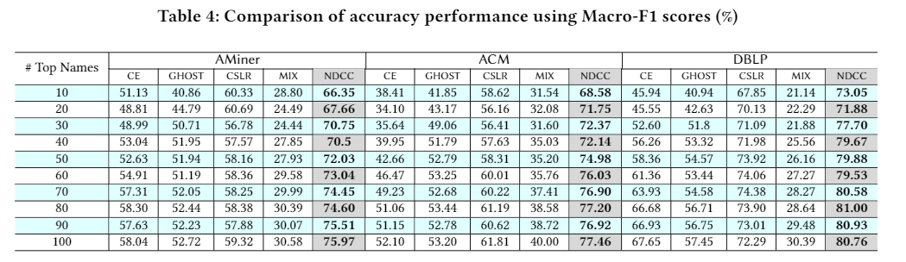
Testing Results

Slide 36
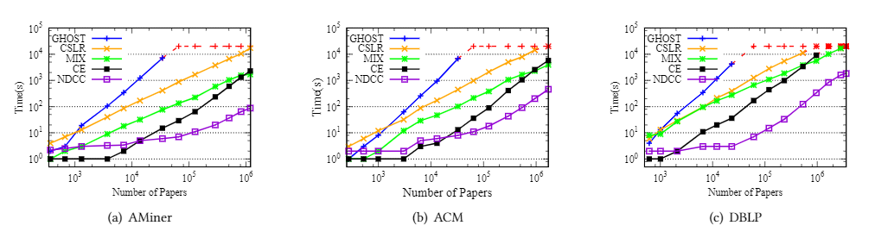
Testing Results
For each datasets, we generate several subsets with different sizes.

Slide 37
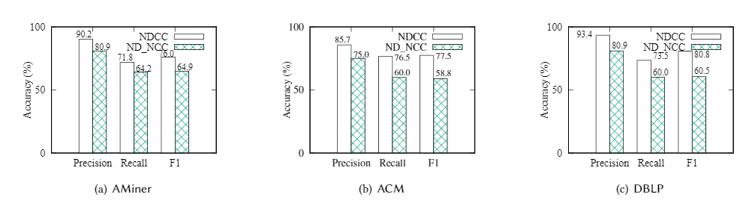
Testing Results
We compare NDCC with its non-collective version (NDNCC), which disambiguated authors names independently.

Slide 38
Outline
Query Independent Scholarly Article Ranking
Scholar Name Disambiguation
Scholarly Citation Cycle Detection and Cleaning
Athena: Ranking Enabled Scholarly Search System

Slide 39
Scholarly Citation Cycle Detection and Cleaning
Belay A. IX: A Protected Dataplane Operating System for High Throughput and Low Latency. In OSDI, 2014.
Peter S , Li J , Zhang I , et al. Arrakis: The Operating System is the Control Plane. In OSDI, 2014.
Peter S , Li J , Zhang I , et al. Arrakis: The Operating System is the Control Plane. TOCS, 2015, 33(4):1-30.
True Example from Microsoft Academic Data
– WSDM Cup 2016 http://www.wsdm-conference.org/2016/wsdm-cup.html

Slide 40
Scholarly Citation Cycle Detection and Cleaning
Caswell J A. Valuing the benefits and costs of improved food safety and nutrition[J]. Australian Journal of Agricultural & Resource Economics, 1998, 42(4):409-424.
Caswell J A, Kleinschmit v L J K. Using Benefit-Cost Criteria for Settling Federalism Disputes: An Application to Food Safety Regulation[J]. American Journal of Agricultural Economics, 1997, 79(1):24-38.
True Example from Microsoft Academic Data
– WSDM Cup 2016 http://www.wsdm-conference.org/2016/wsdm-cup.html

Slide 41
Intrinsic Citation Features
Less citations in papers published in the same years
Much more citations in papers published in different years
Dataset | Citation counts in the same years | ratio | Old to New Ciations | ratio | Citation counts across different years | ratio
AAN | 3,384 | 4.08% | 45 | 0.05% | 79,515 | 95.87%
DBLP | 1,484,419 | 12.07% | 110,738 | 0.77% | 12,525,533 | 87.16%
MAG | 13,164,072 | 2.50% | 213,369 | 0.04% | 513,334,848 | 97.46%
理论上，引用遵循时序：旧文章不会引用新文章 - 强连通分量仅存在同年之间，没有跨年的
实际上，数据中存在年份早引用年份晚的论文 - 只有这些边才会使得跨年的强连通分量产生

Slide 42
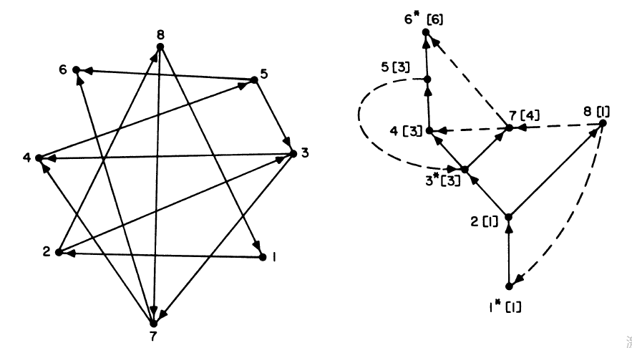
Cycle Detection
Cycle detection can be treated as strong connected component dectection
Algorithm Tarjan
Using DFS to find all the strong connected component
Line time complexity

Slide 43
Block-wise Tarjan
先暂时屏蔽跨年的引用，仅考虑只有同年引用的子图，并在子图上进行强联通分量检测
随后再以年份早到年份晚的论文引用为起点进行深度优先搜索
不必访问一部分跨年引用，从而缩减强连通分量检测的运行时间
数据集 | 同年引用 | 占全图百分比 | 跨年引用 | 占全图百分比
AAN | 3,345 | 4.04% | 79,515 | 95.96%
AMiner | 1,735,125 | 12.17% | 12,525,533 | 87.83%
MAG | 13,164,072 | 2.50% | 513,334,848 | 97.50%

Slide 44
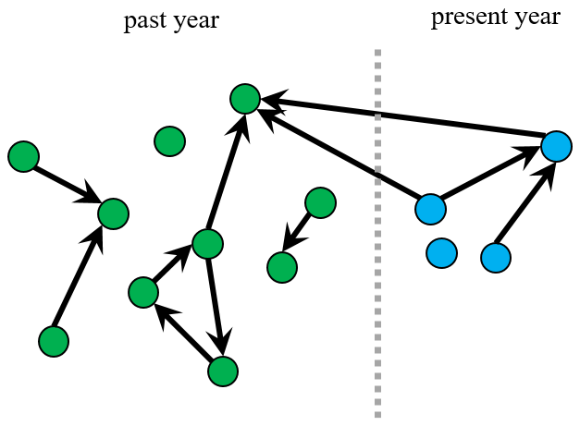
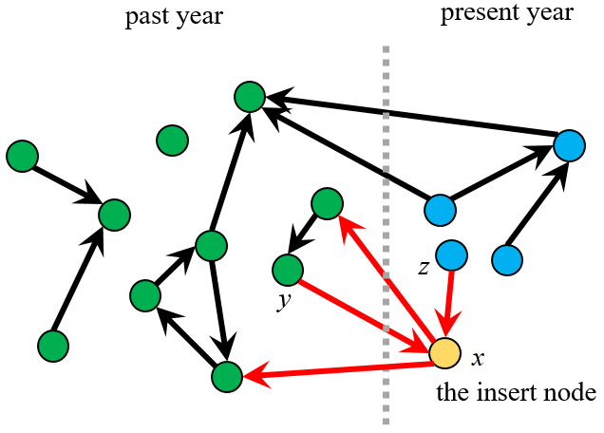
Dynamic Cycle Detection
学术数据不断变化更新，重新检测是不划算的
更新情景：
增加一篇论文以及当前数据库中所有与其相关的引用关系（引用或被引）
只有新增加的论文存在被引时，
才有可能产生新的环

Slide 45
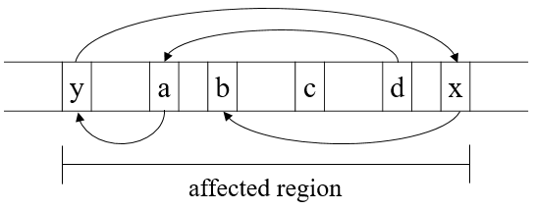
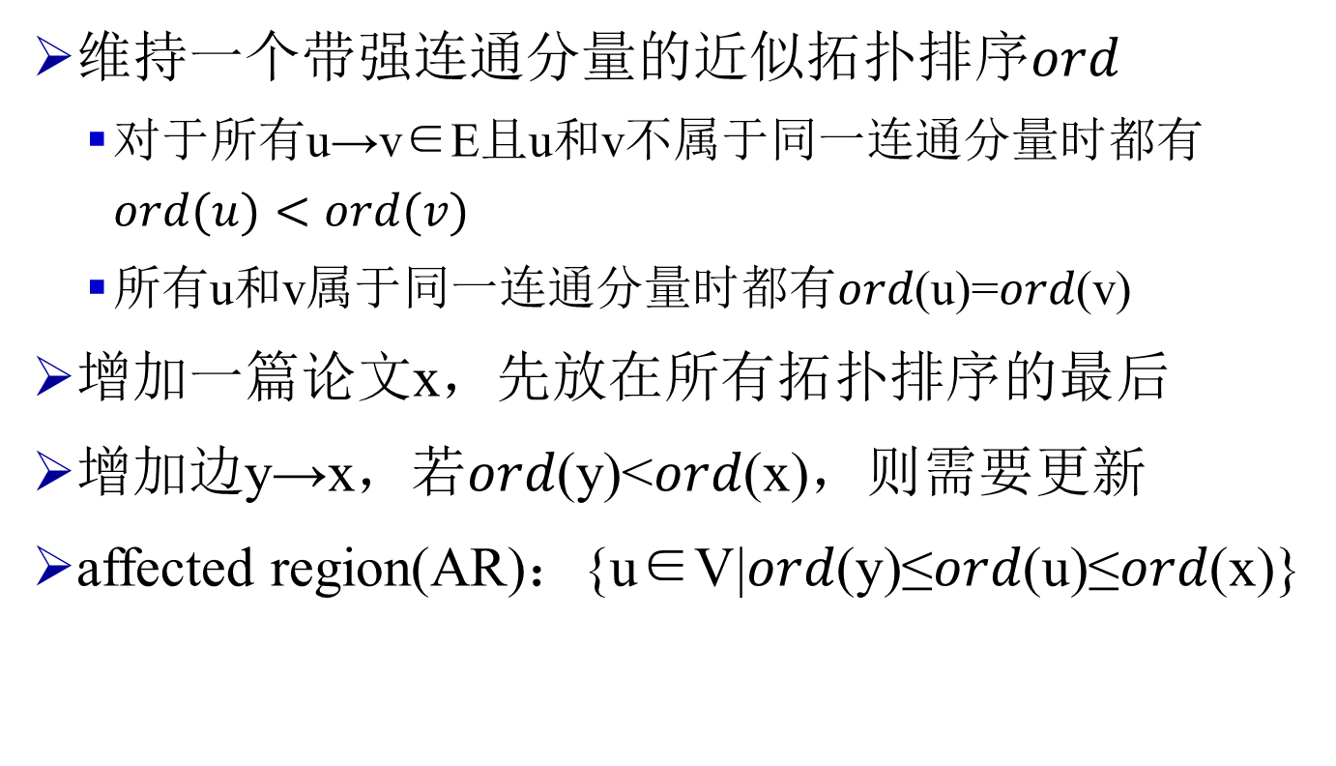
How to check whether an edge produces cycles
维持一个带强连通分量的近似拓扑排序𝑜𝑟𝑑
对于所有u→v∈E且u和v不属于同一连通分量时都有$ord(u)<ord(v)$
所有u和v属于同一连通分量时都有𝑜𝑟𝑑(u)=𝑜𝑟𝑑(v)
增加一篇论文x，先放在所有拓扑排序的最后
增加边y→x，若𝑜𝑟𝑑(y)<𝑜𝑟𝑑(x)，则需要更新
affected region(AR)：{u∈V|𝑜𝑟𝑑(y)≤𝑜𝑟𝑑(u)≤𝑜𝑟𝑑(x)}

Slide 46
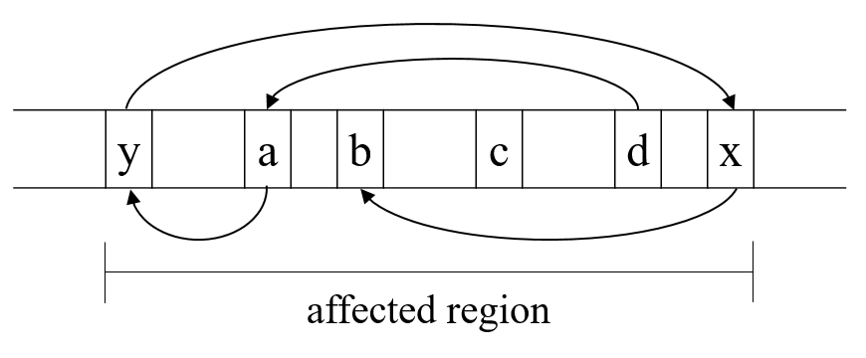
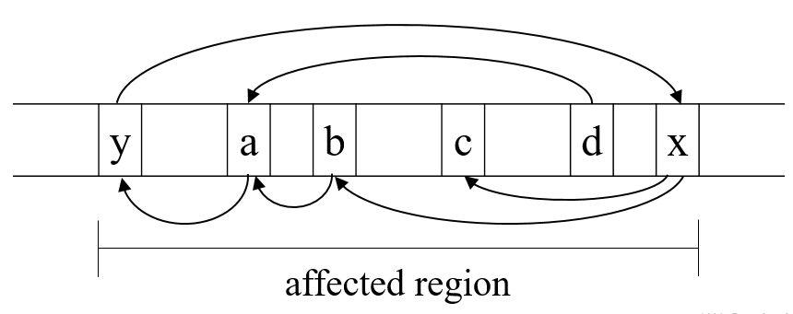
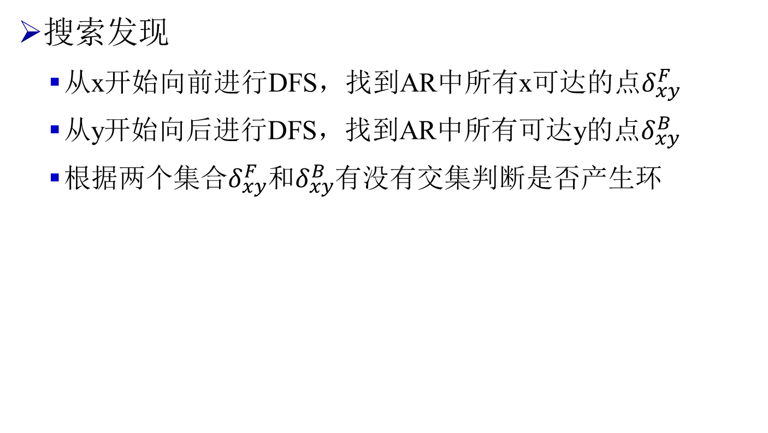
Dynamic Cycle Detection
搜索发现
从x开始向前进行DFS，找到AR中所有x可达的点$δ_{xy}^{F}$
从y开始向后进行DFS，找到AR中所有可达y的点$δ_{xy}^{B}$
根据两个集合$δ_{xy}^{F}$和$δ_{xy}^{B}$有没有交集判断是否产生环
没有产生环
产生了新的环

Slide 47
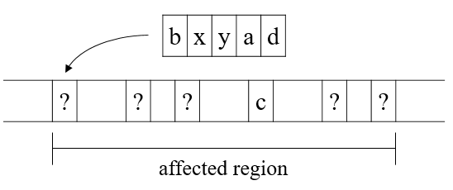
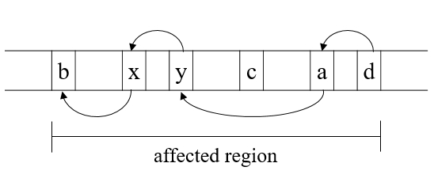
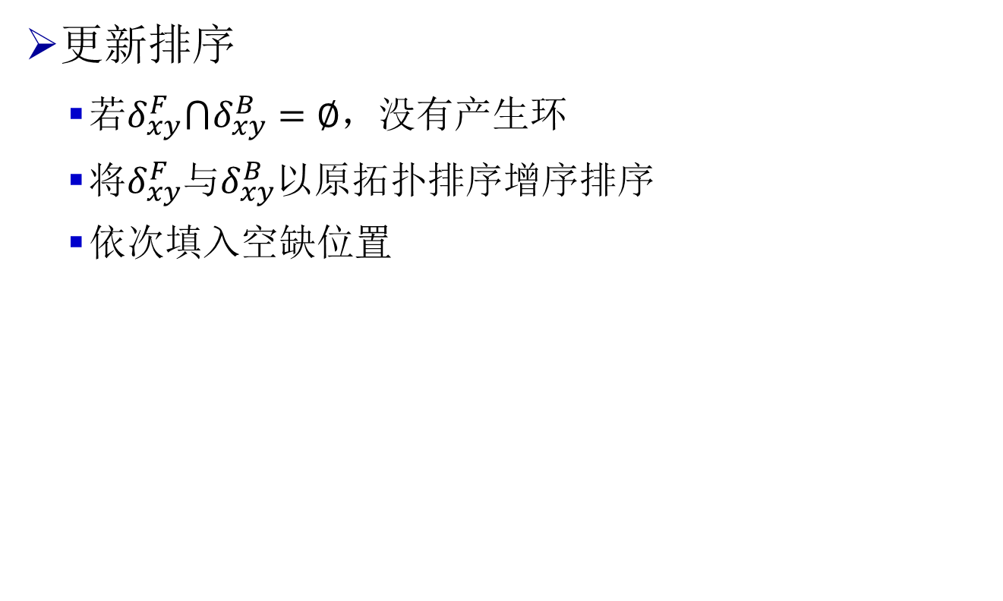
Dynamic Cycle Detection
更新排序
若$δ_{xy}^{F}⋂δ_{xy}^{B}=∅$，没有产生环
将$δ_{xy}^{F}$与$δ_{xy}^{B}$以原拓扑排序增序排序
依次填入空缺位置
将两个集合增序排序
依次填入空缺位置

Slide 48
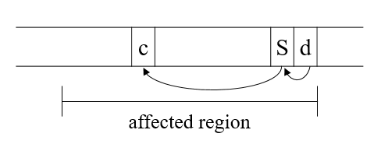
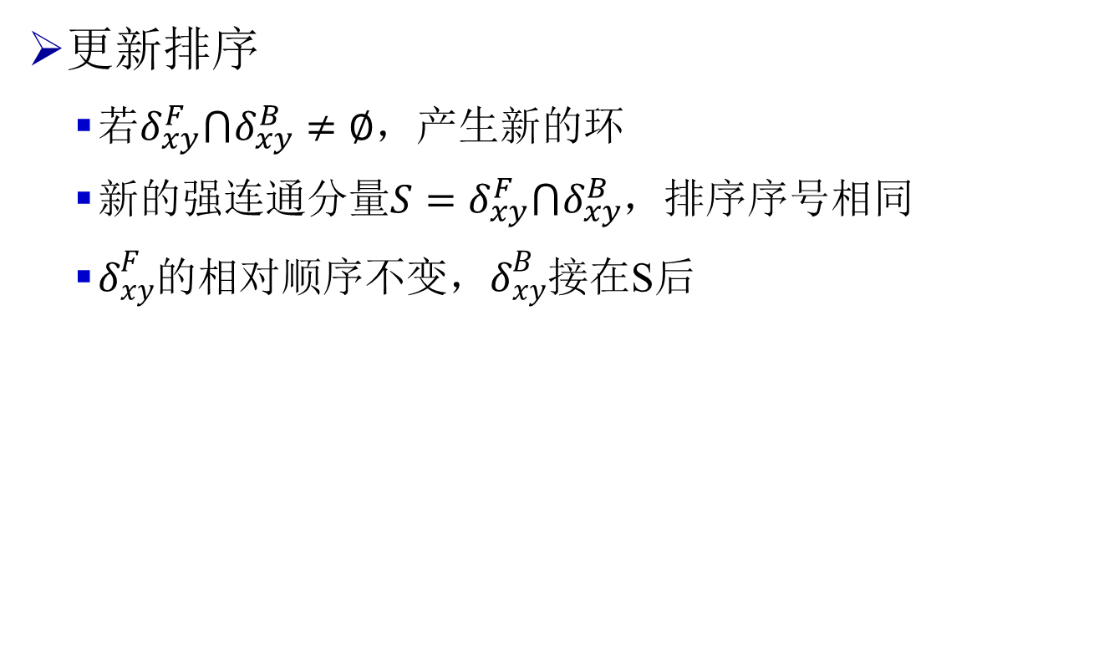
Dynamic Cycle Detection
更新排序
若$δ_{xy}^{F}⋂δ_{xy}^{B}≠∅$，产生新的环
新的强连通分量$S=δ_{xy}^{F}⋂δ_{xy}^{B}$，排序序号相同
$δ_{xy}^{F}$的相对顺序不变，$δ_{xy}^{B}$接在S后

Slide 49

Complexiy
令$δ_{xy}=δ_{xy}^{F}∪δ_{xy}^{B}$，$\left\|δ_{xy}\right\|=\left|δ_{xy}\right|+\left|E(δ_{xy})\right|$
搜索发现：两次DFS，复杂度$O\left(\left\|δ_{xy}\right\|\right)$
排序更新：一次排序，复杂度$O\left(\left|δ_{xy}\right|\log\left|δ_{xy}\right|\right)$
只与affected region的大小有关系

Slide 50
Cycle Cleaning
数据标注
从节点数为2,3,4,>=5的强连通分量中分别挑选300个，人工标注其中同年或年份旧到年份新的论文引用
其中有效数据935个，无效是因为无法判断其中某些边的真实性，由于找不到原文等原因导致的
在标注的这些数据中，共标注边6396条，其中错误的边为660条，占总数的10.3%
边 | 总数 | 正确数量 | 所占百分比 | 错误数量 | 所占百分比
同年引用 | 5732 | 5206 | 90.82% | 526 | 9.18%
旧论文到新论文引用 | 664 | 530 | 79.82% | 134 | 20.18%

Slide 51

Feature Extraction

Slide 52

Feature Extraction
图结构特征
节点的入度和出度，两篇论文是否出现互引
隐含特征
论文重要性分数SARank score
SARank模型[Ma et al. 2018]

Slide 53
Experimental Study
Cycle Detection
数据集
MAG数据集[Sinha et al. 2015]
算法
Tarjan: 原始Tarjan算法[Tarjan 1972]
block-wise Tarjan: 提出的强连通分量分块检测算法
ICD: 动态环检测算法(incremental cycle detection)

Slide 54


Testing Results
Cycle Detection

Slide 55
Experimental Study
Cycle Cleaning
分类方法选取
支持向量机SVM，决策树DT，逻辑回归LR，XGBoost
评价标准
准确率Precision，召回率Recall，F1值F1 score
选取特征
特征 | 数据类型 | 取值 | 特征 | 数据类型 | 取值
题目相似度 | float | [0, 1] | 期刊相似度 | bool | 0/1
作者相似度 | float | [0, 1] | 年份差 | int | [0, +∞)
论文引用差 | int | (-∞, +∞) | 论文被引差 | int | (-∞, +∞)
是否互引 | bool | 0/1 | 论文重要性 分数之差 | float | (-∞, +∞)

Slide 56

Testing Results
实验结果 | SVM | DT | LR | XGBoost
Precision | 0.671073 | 0.631655 | 0.682819 | 0.693599
Recall | 0.666229 | 0.630691 | 0.683047 | 0.692752
F1 | 0.661417 | 0.630652 | 0.682721 | 0.692901

Slide 57
Outline
Query Independent Scholarly Article Ranking
Scholar Name Disambiguation
Scholarly Citation Cycle Detection and Cleaning
Athena: Ranking Enabled Scholarly Search System

Slide 58

Athena: A Ranking Enabled Scholarly Search System

Slide 59

Athena System Architecture

Slide 60
Athena System Architecture

Slide 61
Athena Scholarly Ranking Model
Scholarly Article Ranking
Citation counts and publish time
Importance – SARank
Relevant importance
Author, Venue and Affiliation Ranking
Stand-alone ranking
the sum of the query independent ranking scores of all their associated articles
when sorting entities by publish time, uses an exponentially decayed ranking score e^{Ta−T0} to evaluate the research activeness of an entity, where Ta is the publish year of an article a, and T0is the current year.
Article-coupled ranking

Slide 62

Athena System Demo – Scholarly Search

Slide 63

Athena System Demo – Author Profiling

Slide 64

Athena System Demo – Graph Stroage
Three types of queries:
given an article ID, finding its title and authors,
given an article ID, finding its top–10 most important citations，
given an author ID, finding her/his published top–10 most important articles.
The numbers of joins are (2, 3, 4) for the three types of queries in MySQL, respectively
We randomly select 1000 articles and 100 authors whose citation counts and published articles are no less than 100 and 50, respectively, and compute the average processing time.

Slide 65


Acknowledgements
Collaborators:
Chen Gong, Renjun Hu, Chunming Hu, Dongshegn Luo, Luoshu Wang…
They are from:

Slide 66

主页: http://mashuai.buaa.edu.cn
邮件: mashuai@buaa.edu.cn
地址:
新主楼G1122,
北京航空航天大学
Thanks!

